Slide 1



Initial Economic Impact Analysis
COVID-19 and Maine Gas Tax

Slide 2


What am I doing?
What is the expected gasoline tax revenue (based on past values)?
What is the relationship between traffic levels and gasoline tax revenue?
Can I use traffic levels to predict the revenue?
Can predicted revenue be compared to expected revenue?

Slide 3


Step 1. Expected revenue
Observations: 138
Monthly
ADF: -1.0433
(p < 0.01)
ADF: -6.7918
(p < 0.01)
July 2006
June 2018

Slide 4

Step 1. Expected revenue
ACF
SARIMA
(0, 1, 1) (1, 1, 0) 12
PACF

Slide 5
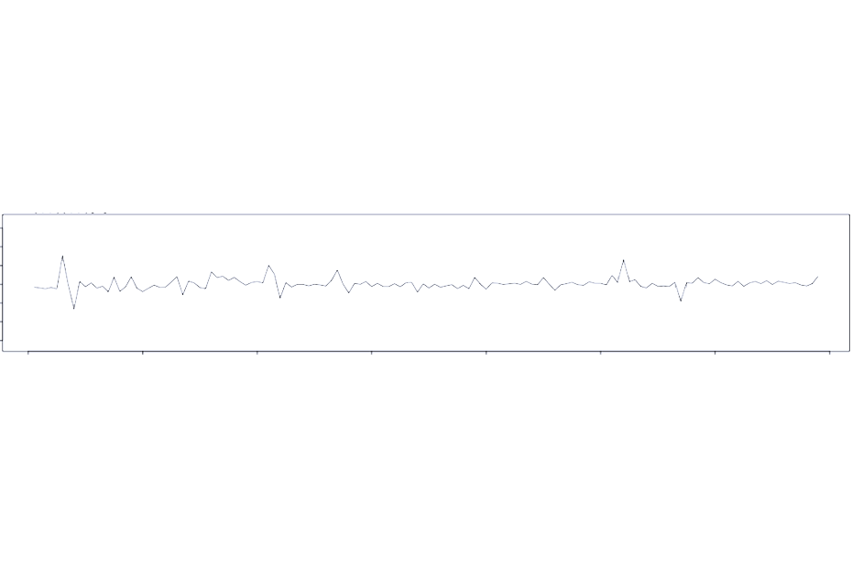
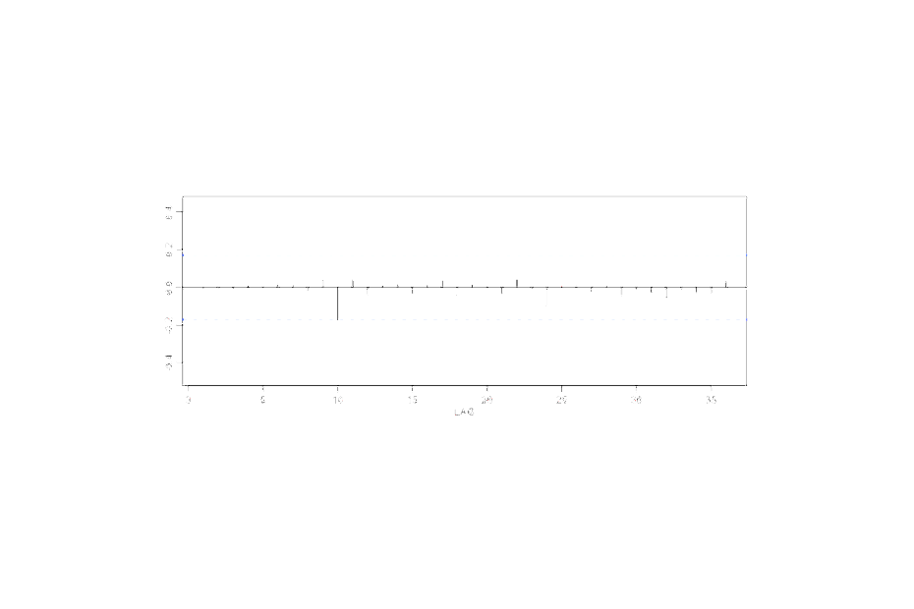


Step 1. Expected revenue
Standardized Residuals
ACF of Residuals
Normal Plot of Std. Residuals
Ljung-Box p values
Lag 25

Slide 6

Step 1. Expected revenue
Forecast for 2019
July 2006
June 2019

Slide 7
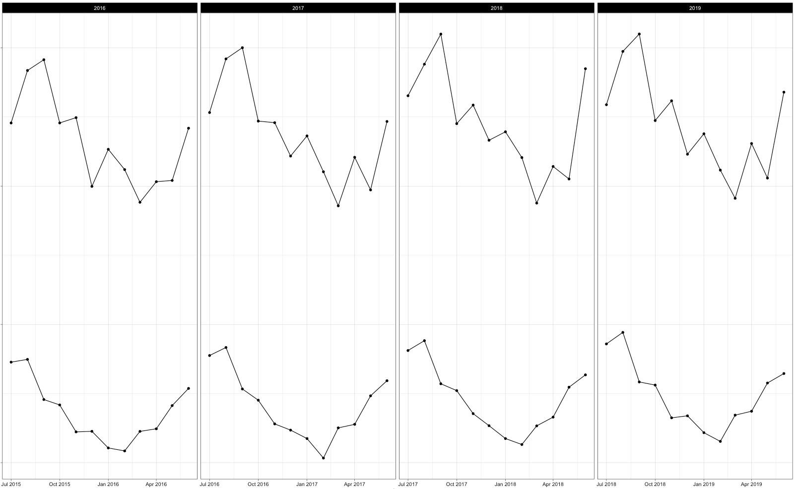
Step 2. Revenue vs. Traffic

Slide 8
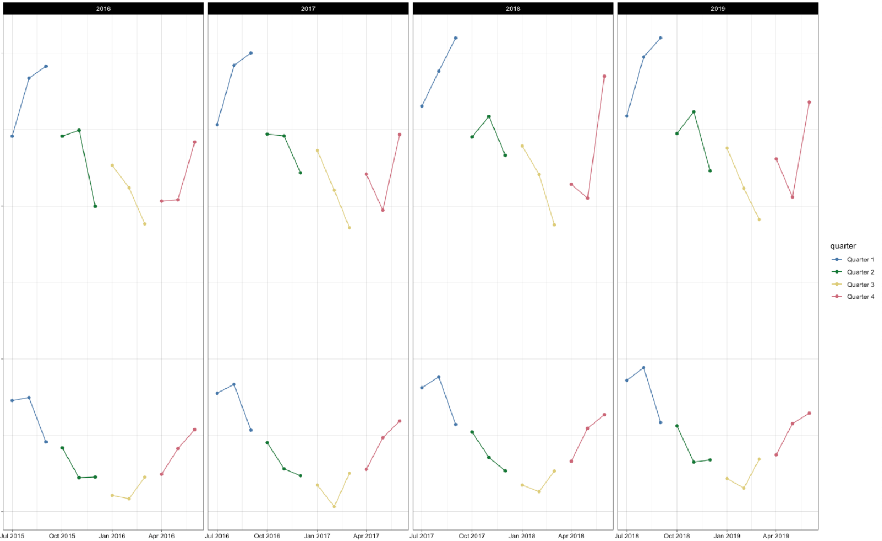
Step 2. Revenue vs. Traffic

Slide 9
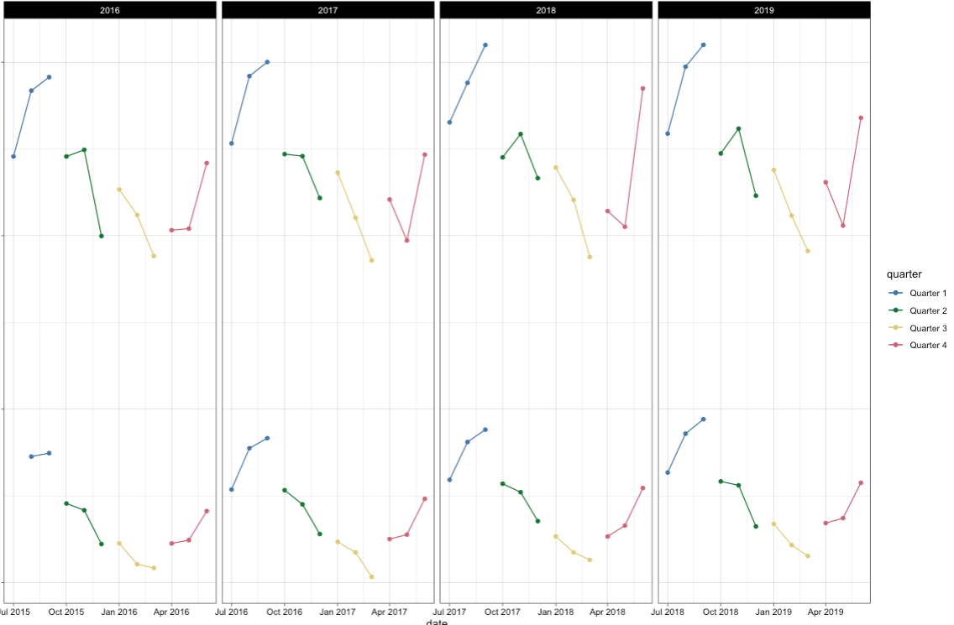
Step 2. Revenue vs. Traffic

Slide 10
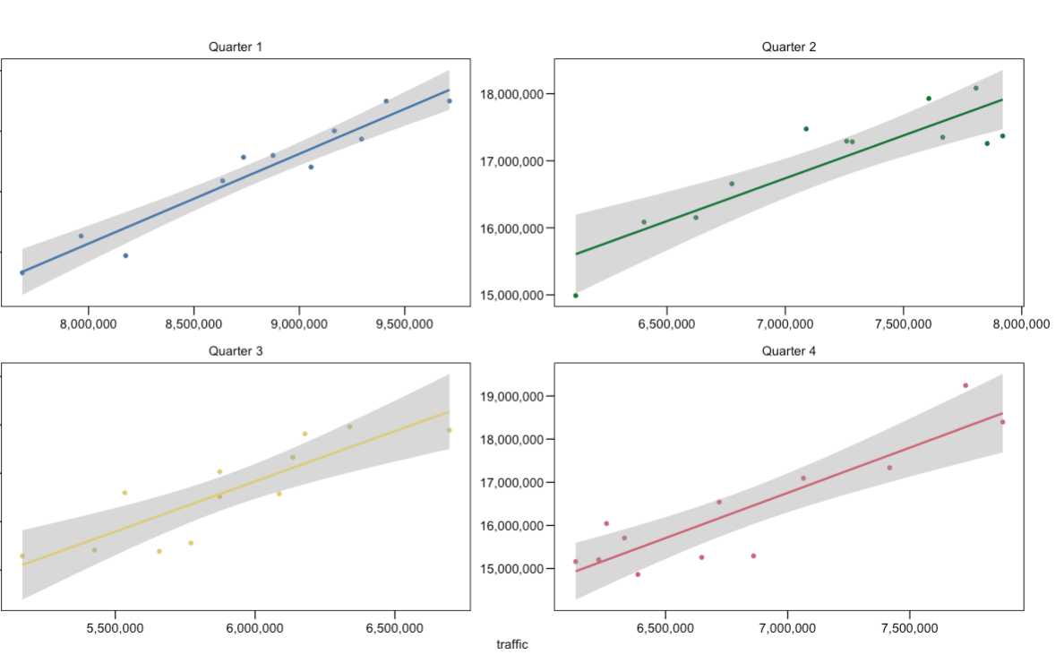
Step 2. Revenue vs. Traffic

Slide 11
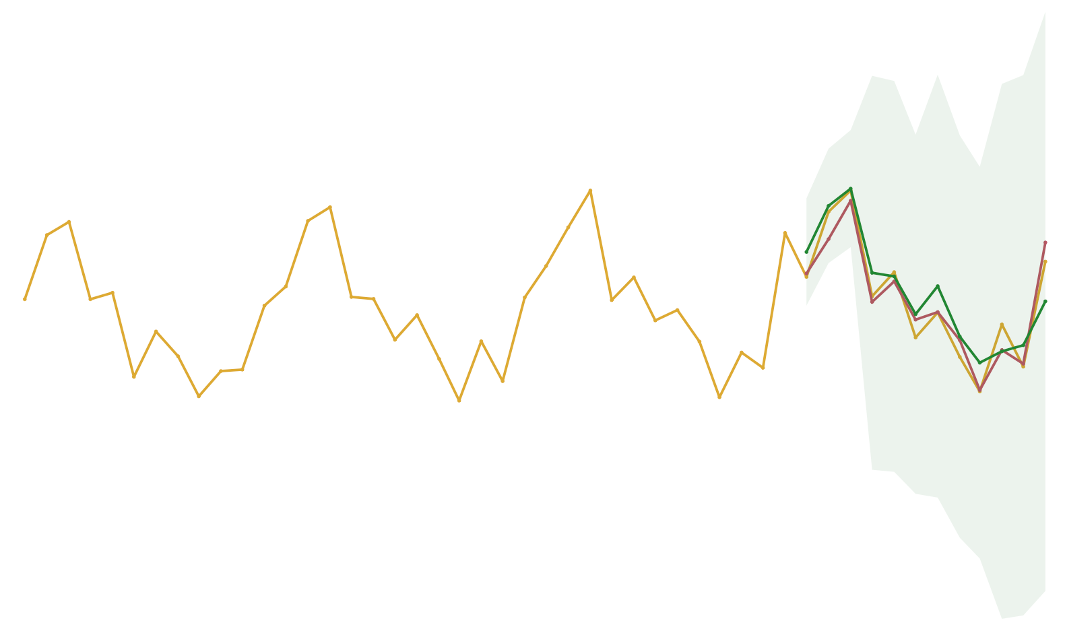
Step 3. Putting it all together
Prediction (OLS)
Expectation (ARIMA)
Actual data
June 2019

Slide 12
THE END

